Slide 1
Python datetime library & MySql
Elapsed time calculations using the datetime library

Slide 2
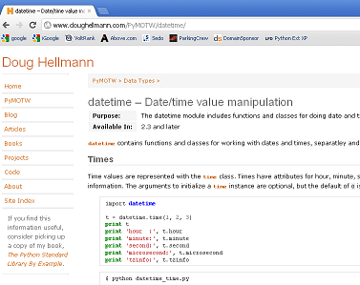
Datetime resources
datetime.timedelta

Slide 3
Internal date and time formats
Unix timestamp – seconds from the epoch, where the epoch is January 1, 1970
Php: $a = time();
Python: dateStart=datetime.date.today()
?? Maybe yyyy-mm-dd hh:mm:ss:uu

Slide 4
Taking a look at python
a=datetime.datetime.today()
print 'today =>', a
today => 2012-03-08 15:09:02.918348

Slide 5
Seven and eight days ago
#!/usr/bin/python
import datetime
dateStart=datetime.date.today() - datetime.timedelta(days=8)
dateStar7=datetime.datetime.combine(
dateStar7,datetime.time() );

Slide 6
Get some MySql Data
Import cred2
handle=cred2.dbconn()
cur1=handle.cursor()
cur2=handle.cursor()
Sql1=“””select id,employee_name FROM
ms_h_employee order by last_name”””;
Cur1.execute(sql1); res1=cur1.fetchall()

Slide 7
Loop the results
For row1 in res1
id, employee_name = row1
sql2=“””select * from ms_h_emptc where
emp_id=“”” + str(id) + “””
date>’””” + str(dateStar7) +”””’ order by
date,time_in ASC”””

Slide 8
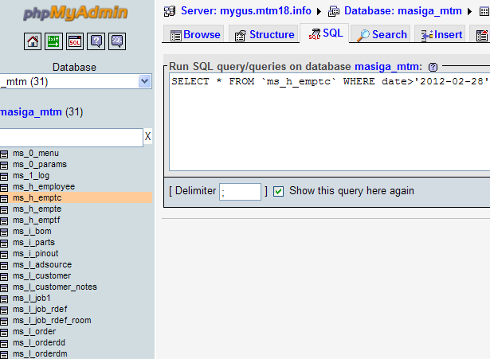
Test your sql

Slide 9
Adding things up
totalHours = datetime.timedelta()
for row2 in res2
id, time_in, time_out, date = row2
dtIn=datetime.datetime.combine(
date,datetime.time(0,0,0) ) + time_in
dtOut =datetime.datetime.combine(
date,datetime.time(0,0,0) ) + time_out

Slide 10
More adding things up
tcHours = dtOut - dtIn
totalHours + tcHours
print str("%.2f" % (totalHours.days*24.0 + totalHours.seconds/3600.0) ).rjust(6)

Slide 11
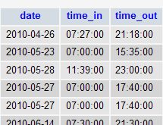
MySql works with datetime?
Phpmyadmin – field type ‘time’

Slide 12
MySql without datetime lib
[apia]$ python
Python 2.5.2 (r252:60911, Jan 24 2010, 17:44:40)
[GCC 4.3.2] on linux2
>>> import cred2
>>> handle=cred2.dbconn()
>>> cur1=handle.cursor()
>>> cur1.execute("select time_in from ms_h_emptc")
17242L
>>> res1=cur1.fetchall()

Slide 13
Slide 2 (never got datetime lib)
>>> print res1[0]
(datetime.timedelta(0, 26820),)
>>> x=res1[0]
>>> print "x=",x
x= (datetime.timedelta(0, 26820),)
>>> x=datetime.datetime.now()
Traceback (most recent call last):
File "<stdin>", line 1, in <module>
NameError: name 'datetime' is not defined
>>>

